Slide 1
The Lord’s Prayer
Language Literacy and Communication Activities
PS3 - I can understand that there are connections between language, culture and identity and that these differ within Wales and around the world.

Slide 2
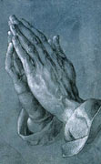
The Lord’s Prayer is also called ‘Pater Noster’ which means ‘ Our Father’ in Latin.
Jesus would have spoken The Lord’s Prayer to his disciples in the ancient language of Aramaic, which is an older version of Hebrew.
By the time the Lord’s prayer was written down it would have been written in Greek, then Latin, and much, much later, in Old English and also in Welsh.

Slide 3
The Lord’s Prayer has been written in many languages:
https://www.wordproject.org/bibles/resources/our_father/in_many_languages.htm
Including sign language https://youtu.be/5lNr-nOEmyE

Slide 4
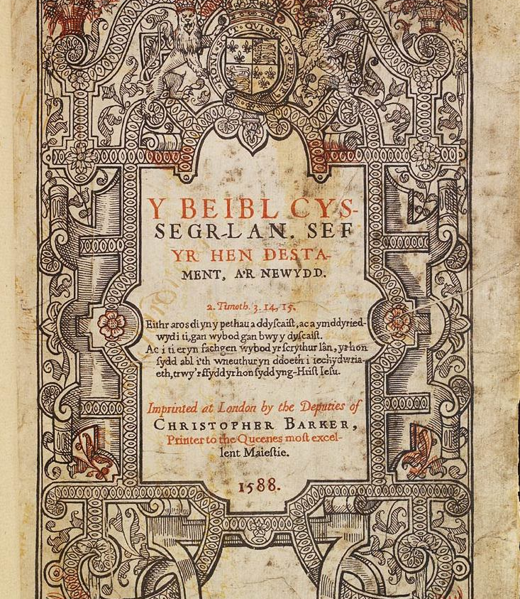
The history of translation of the Bible and prayer is full of drama!
People often worked secretly to translate the Bible into their own language.
Here is a fun video about the translation of the Bible into Welsh.
https://youtu.be/0ikNxAJmij8
In 1588 Welsh became the 13th language into which the whole Bible was translated.

Slide 5
Overview of activities
Activity 1 | History of the Anglo Saxon Language (Old English)
Activity 2 | Similarities and differences between Old and Modern English
Activity 3 | Links between Old English, Modern English and German
Activity 4 | Etymology of the word ‘Father’
Activity 5 | Links between Languages

Slide 6
Activity 1
Learn about the history of Anglo Saxon Language (Old English)

Slide 7
Fæder ure, ðu ðe eart on heofonum,
Father our, thou that art in the heavens,
Si ðin nama gehalgod. be thy name hallowed.
Tobecume ðin rice, may it come, thy kingdom,
Gewurde ðin willa on eorþan, may it be realised, thy will on the earth, swa swa on heofonum. as also in the heavens.
Urne gedæghwamlican hlaf syle us todæg.
Our daily loaf give us today.
And forgyf us ure gyltas,
And forgive us our guilts swa swa we forgyfaþ urum gyltendum. as also we forgive those guilty towards us.
And ne gelæd ðu us on costnunge,
And do not thou lead us into temptation ac alys us of yfele.
But free us from evil.
Soþlice.
Amen.
[The sounds represented by ð (called ‘eth’) and þ (called ‘thorn’) would be represented in modern English by ‘th’] (Literal Translation here)

Slide 8
Old English | Old English Phonetic (TH) | Modern English
Fæder ure, ðu ðe eart on heofonum | Fairther ooray, thoothay airt on hairfonum | Our Father who art in Heaven
Si ðin nama gehalgod | Sea then Narmer yer halgod | Hallowed be thy name
Tobecume ðin rice, | Torbeh comer theen reecher | Thy Kingdom come
Gewurde ðin willa on eorþan, | Yay woorther theen willah orn airthen | Thy will be done, on earth
swa swa on heofonum. | Swah swah on hairfonum | As it is in heaven.
Urne gedæghwamlican hlaf syle us todæg. | Oornay yeah die cwam llee chanllath sula oos toodie | Give us this day our daily bread.
And forgyf us ure gyltas, | Und forgive oos oora guiltas | And forgive us our trespasses
swa swa we forgyfaþ urum gyltendum. | Swah swah way forgiveth oorem guiltendum | As we forgive those who trespass against us
And ne gelæd ðu us on costnunge, | Und nay yerlaider thoo oos oon cosnoonger | And lead us not into temptation
ac alys us of yfele. | Ac aloos us orf oofelah | But deliver us from evil
Soþlice. | Sothleecheh | For thine is the kingdom, the power and the glory, forever and ever, Amen

Slide 9
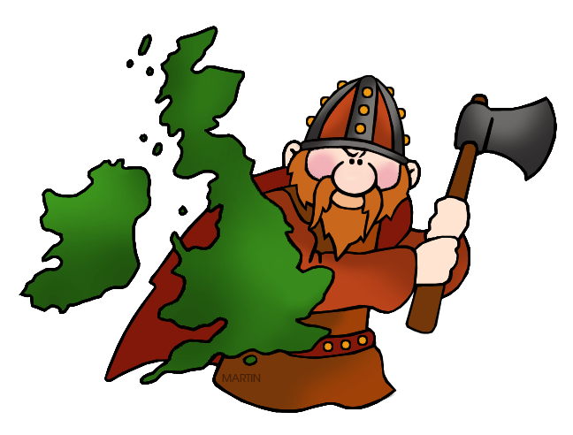
Who spoke this Old English?
The Anglo-Saxons!

Slide 10
Who were the Anglo-Saxons?
The Anglo-Saxons came to England after the Romans left in the year 410. Nobody was really ruling all of England at the time – there were a lot of little kingdoms ruled by Anglo-Saxons that eventually came together as one country.
The earliest English kings were Anglo-Saxons, starting with Egbert in the year 802. Anglo-Saxons ruled for about three centuries, and during this time they formed the basis for the English monarchy and laws.
The two most famous Anglo-Saxon kings are Alfred the Great and Canute the Great.

Slide 11
Anglo-Saxons once worshipped lots of different gods that they believed controlled all areas of life, but around the 7th century many converted to Christianity after the arrival of the missionary St. Augustine from Rome.
Some of our modern English words, such as the days of the week, come from the Anglo-Saxon language (sometimes called Old English).
Anglo-Saxon uses many of the letters found in Modern English (though j, q, and v are not included and the letters k and z are very rarely used) as well as three extra letters: þ ð æ
More Information: https://www.bbc.co.uk/bitesize/topics/zxsbcdm/articles/zq2m6sg

Slide 16
Where did the Anglo-Saxon Language come from?
When the Anglo-Saxons first came to England from northern Germany (Saxony), they brought their language with them. It was a Germanic language and has some fundamental similarities to German.
But political and cultural events changed the Anglo-Saxon language into the language we speak today e.g. the Norman invasion brought the French language and so the English we speak today has been changed and adapted by many other influences.

Slide 17
Activity 2
Find similarities between Anglo Saxon English and Modern English
Play Pictionary with the Anglo Saxon words.
Research into Anglo Saxon words now used in Modern English – wordsearch translation Modern English –> Anglo Saxon

Slide 18
Fæder ure, ðu ðe eart on heofonum,
Father our, thou that art in the heavens,
Si ðin nama gehalgod. be thy name hallowed.
Tobecume ðin rice, may it come, thy kingdom,
Gewurde ðin willa on eorþan, may it be realised, thy will on the earth, swa swa on heofonum. as also in the heavens.
Urne gedæghwamlican hlaf syle us todæg.
Our daily loaf give us today.
And forgyf us ure gyltas,
And forgive us our guilts swa swa we forgyfaþ urum gyltendum. as also we forgive those guilty towards us.
And ne gelæd ðu us on costnunge,
And do not thou lead us into temptation ac alys us of yfele.
But free us from evil.
Soþlice.
Verily.
[The sounds represented by ð (called ‘eth’) and þ (called ‘thorn’) would be represented in modern English by ‘th’] (Literal Translation here)
Which words could you recognize from the Anglo Saxon?
What similarities and differences can you see between the Anglo Saxon and the Modern English?

Slide 19
Let’s look at some of the words from the Lord’s Prayer
Can you match them up?
heofonum
Father
nama
today
Fæder
heaven
todæg
evil
yfele
name

Slide 20
Heofonum | Nama | Fæder | Todæg
Gyltas | Hlaf | Eorþan | Yfele

Slide 21
Old Anglo-Saxon English
What similarities and differences can you see between these Anglo Saxon words and the Modern English?

Slide 22
Old English Words – Can you find what these mean in today’s English?
Blæd
Bisignes
Freond
Gamen
Hærfest
Cniht
Neahgebur
Rædan
Sweord

Slide 23
Old English Words – in modern English
Blade
Business
Friend
Game
Harvest
Knight
Neighbour
Read
Sword

Slide 24
Blæd – This word meant leaf, or blade of grass. It could also refer to anything leaf shaped like an oar.
Bisignes – This word meant anything that you cared about or kept you occupied.
Freond – One of the English language’s oldest words!
Gamen – This word used to mean ‘people together’
Hærfest – In Old English this word was the name for the autumn season, when many crops are ripe.
Cniht – This word didn’t mean the noble warrior we think of today but he was a young boy who was a helper to someone noble.
Neahgebur – This word literally means ‘near-dweller’ a combination of neah meaning ‘near’ and ‘gebur’ meaning ‘dweller’.
Rædan – In Old English this word had many meaning but it mainly meant ‘to advise’. An advisor is someone who can help you understand something or explain a new idea – just like reading a book can!
Sweord – This word has hardly changed today! It meant ‘to cut or pierce’.
Are there any other Old English words that we use today?
Try looking up a few, perhaps Marshmallow or Whale!

Slide 26
Activity 3
Link to German – history of languages tree
Matching up activity – Modern English, Old English and German from the words in the Lord’s Prayer
Cognates

Slide 27
A link to German?
Many of our common words from the language of the Anglo-Saxons (Old English). It originally comes from a much older language group called Germanic, which is also the ancestor of the German, Dutch and Scandinavian languages.

Slide 28
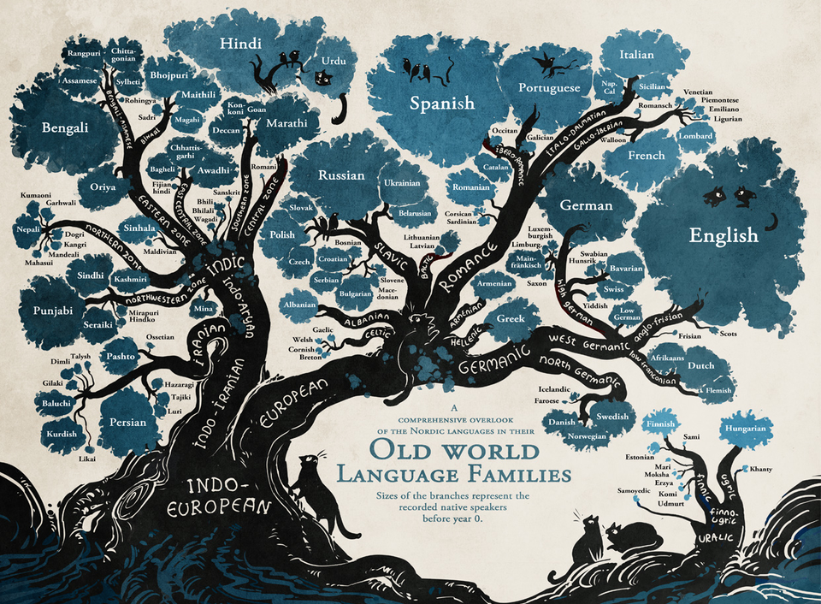

Slide 29
Old English | Modern English | German | Heofonum | Nama | Fæder
Todæg | Yfele | Heaven | Name | Father | Today
Evil | Himmel | Name | Vater | Heute | Übel

Slide 30
What similarities and differences can you spot?
The answers
Old English
Modern English
German
heofonum
heaven
Himmel
nama
name
Name
Fæder
Father
Vater
todæg
today
heute
yfele
evil
übel

Slide 31
Cognates
As English and German are linked through the ‘Germanic’ section of the languages tree there are many other words that we find are similar. These are called cognates. Have a look at these next words – what do you think they mean?

Slide 34
Activity 4
Etymology (History of the word) Father
Spot word families on the map – shade the words the same colour which you think belong to the same family. What patterns can be found?

Slide 37
Activity 5
To find links between languages
Have a look at the different versions of the Lord’s Prayer in Welsh, French, Spanish and German. Can you use your knowledge to find the linked words and then fill in the table.
Which words were easiest to find – why?
Can you add the English words to the list.

Slide 38
French
Notre Père, qui es aux cieux,
Que ton nom soit sanctifié,
Que ton règne vienne,
Que ta volonté soit faite sur la terre comme au ciel.
Donne-nous aujourd'hui notre pain de ce jour.
Pardonne-nous nos offences
Comme nous pardonnons aussi à ceux qui nous ont offensés.
Et ne nous soumets pas à la tentation, mais délivre-nous du mal,
car c'est à toi qu'appartiennent le règne,
la puissance et la gloire, aux siècles des siècles.
Amen.

Slide 39
Spanish
Padre Nuestro, que estás en el cielo
santificado sea tu nombre,
venga tu reino,
Hagase tu voluntad,
en la tierra como en el cielo,
danos hoy nuestro pan de cada día,
perdona nuestras ofensas,
a los que nos ofenden,
no nos dejes caer en tentacion,
y líbranos del mal,
Amén

Slide 40
German
Vater unser im Himmel,
geheiligt werde dein Name;
dein Reich komme;
dein Wille geschehe,
wie im Himmel so auf Erden.
Unser tägliches Brot gib uns heute.
Und vergib uns unsere Schuld,
wie auch wir vergeben unsern Schuldigern;
und führe uns nicht in Versuchung,
sondern erlöse uns von dem Bösen.
Denn dein ist das Reich und die Kraft
und die Herrlichkeit in Ewigkeit.
Amen.

Slide 41
Welsh
Ein Tad, yr hwn wyt yn y nefoedd,
sancteiddier dy enw.
Deled dy deyrnas.
Gwneler dy ewyllys,
megis yn y nef, felly ar y ddaear hefyd.
Dyro i ni heddiw ein bara beunyddiol.
A maddau i ni ein dyledion,
fel y maddeuwn ninnau i'n dyledwyr.
Ac nac arwain ni i brofedigaeth, eithr gwared ni rhag drwg.
Canys eiddot ti yw'r deyrnas, a'r gallu, a'r gogoniant yn oes oesoedd.
Amen.

Slide 42
Welsh | French | Spanish | German | English
 | Père
 |  | Nombre
Nefoedd |  |  | Himmel
Ddaer | Terre |  | Erden
 | Pain
Dyledion |  | Ofensas | Schuld
 |  | - | Herrlichkeit | Glory
 |  | mal | Bösen | Bad
Ein |  |  |  | Our

Slide 43
Welsh | French | Spanish | German | English
Tad | Père | Padre | Vater | Father
Enw | Nom | Nombre | Name | Name
Nefoedd | Ciel | Cielo | Himmel | Heaven
Ddaer | Terre | Tierra | Erden | Earth
Bara | Pain | Pan | Brot | Bread
Dyledion | Offences | Ofensas | Schuld | Trespasses
Gogoniant | Gloire | - | Herrlichkeit | Glory
Drwg | Mal | Mal | Bösen | Bad
Ein | Notre | Nuestro | Unser | Our

